Slide 1

UNITED, WE CREATE PATHWAYS TO POTENTIAL
Your logo goes here

Slide 2
HARD WORK ≠ STABILITY
40% of your neighbors are making impossible choices, such as:
Fix the Car –or- Pay Rent
Find Daycare –or- Lose Employment
Refuse Overtime –or- Lose Benefits

Slide 3


WHO DO WE HELP?
ALICE families, working people who lack resources to meet a basic budget
Asset Limited
Income Constrained
Employed

Slide 4
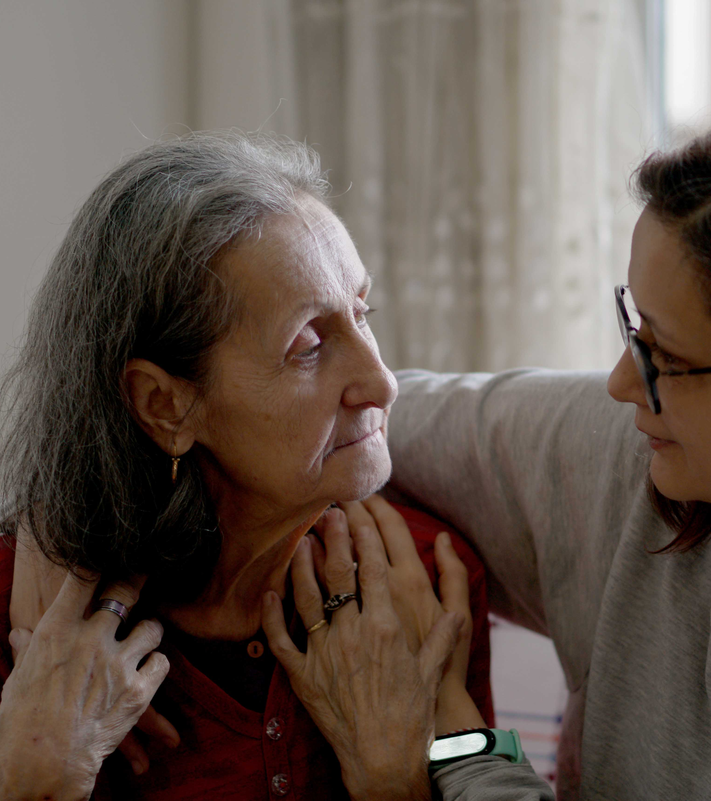
WHAT DOES HELPING OTHERS MEAN TO YOU?

Slide 5

REAL PEOPLE, REAL IMPACT
Kendra* is a single mom trying to provide for her child. She’s been fired from several jobs because she can’t find affordable, stable childcare. Kendra was connected with emergency childcare so she could take a food service job. With quality care for her child and other resources, she’s been able to stay at her job – earning a promotion and a raise! It’s the first time she’s ever earned either, which has boosted her self-esteem.

Slide 6

REAL PEOPLE, REAL IMPACT
Jenna* needed mental health services after running away from her home, where there was conflict and psychological abuse. She was anxious and depressed. But Jenna quickly thrived in therapy and was able to continue attending high school. With the support of intensive therapy and through her hard work, she graduated from high school and got a job. Jenna was even able to negotiate a raise thanks to her newly-found confidence! She is now planning to leave the residential program and move into her own apartment.

Slide 7

REAL PEOPLE, REAL IMPACT
Sierra*, a single mother striving to build a better future for her children, was working toward qualifying for a Habitat for Humanity home when she was initially denied due to disqualifying debt. Thanks to United Way funding, Habitat for Humanity of Evansville launched the Almost Home program, which provides financial education and debt reduction support. Through this program, individuals and families like Sierra can overcome financial barriers and achieve homeownership, creating lasting, generational change.

Slide 8

THE PATH
OF SUCCESS

Slide 9


Slide 10
THE PATH
OF SUCCESS

Slide 11

BEHIND EVERY NUMBER IS A NEIGHBOR

Slide 12


Slide 13
BEHIND EVERY NUMBER IS A NEIGHBOR

Slide 14





UNITED IS THE PATHWAY TO POTENTIAL
EMPOWERING EMPLOYMENT
MENTAL HEALTH
Build skills & remove barriers
to finding & keeping a job
Advocate for and improve
access to mental health
THRIVING NEXT GEN
SOCIAL STABILITY & GROWTH
Provide mentorship and the
support kids need to thrive
Strengthen social networks & life skills
to help people move toward stability

Slide 15


UNITED WAY PROGRAMS
VITA
VOLUNTEER INCOME TAX ASSISTANCE

Slide 16

UNITED WAY PROGRAMS
VITA
K-CAMP
VOLUNTEER INCOME TAX ASSISTANCE
KINDERGARTEN READINESS PROGRAM

Slide 17

UNITED WAY PROGRAMS
VITA
K-CAMP
AMPLIFY
VOLUNTEER INCOME TAX ASSISTANCE
KINDERGARTEN READINESS PROGRAM
OUTREACH AND COMMUNITY BUILDING

Slide 18

UNITED WAY PROGRAMS
IMAGINATION LIBRARY
VITA
K-CAMP
AMPLIFY
VOLUNTEER INCOME TAX ASSISTANCE
KINDERGARTEN READINESS PROGRAM
OUTREACH AND COMMUNITY BUILDING
FREE BOOKS EVERY MONTH UNTIL AGE 5

Slide 19


YOUR DONATION’S PATHWAY
Transportation to Work
Low Income Receive Therapy
Kids Find a Trusted Adult

Slide 20
THE PATHWAY TO POTENTIAL
CHILDCARE
Kept Job
Promotion
STABILITY

Slide 21
THE PATHWAY TO POTENTIAL
CHILDCARE
THERAPY
Kept Job
Better Coping
Promotion
Returned Home
STABILITY
GED & JOB

Slide 22
THE PATHWAY TO POTENTIAL
CHILDCARE
THERAPY
MENTORS
Kept Job
Better Coping
College Interest
Promotion
Returned Home
Improved Grades
STABILITY
GED & JOB
COLLEGE VISIT

Slide 23
THE PATHWAY TO POTENTIAL
CHILDCARE
THERAPY
MENTORS
FINANCIAL COACHING
Kept Job
Better Coping
College Interest
Financial Skills
Promotion
Returned Home
Improved Grades
Paid Off Debt
STABILITY
GED & JOB
COLLEGE VISIT
HABITAT HOME

Slide 24
HOW DO WE HELP?
By partnering with YOU!
We maximize the power of collective giving to make meaningful change in the lives of your neighbors.

Slide 25
WHAT HAPPENS
IF NO ONE GIVES?

Slide 26
YOUR NEXT STORY
STARTS HERE
Remember the memory you thought of earlier? Today is an opportunity to do that for many more of your neighbors.
JOIN US.

Slide 27
Thank you!

Slide 28
Insert details about the incentives you are offering to your employees who donate to United Way SWI.

